Slide 1
Helping Kids Use Social Media Responsibly:
A Guide to Social Media TestDrive

Slide 2
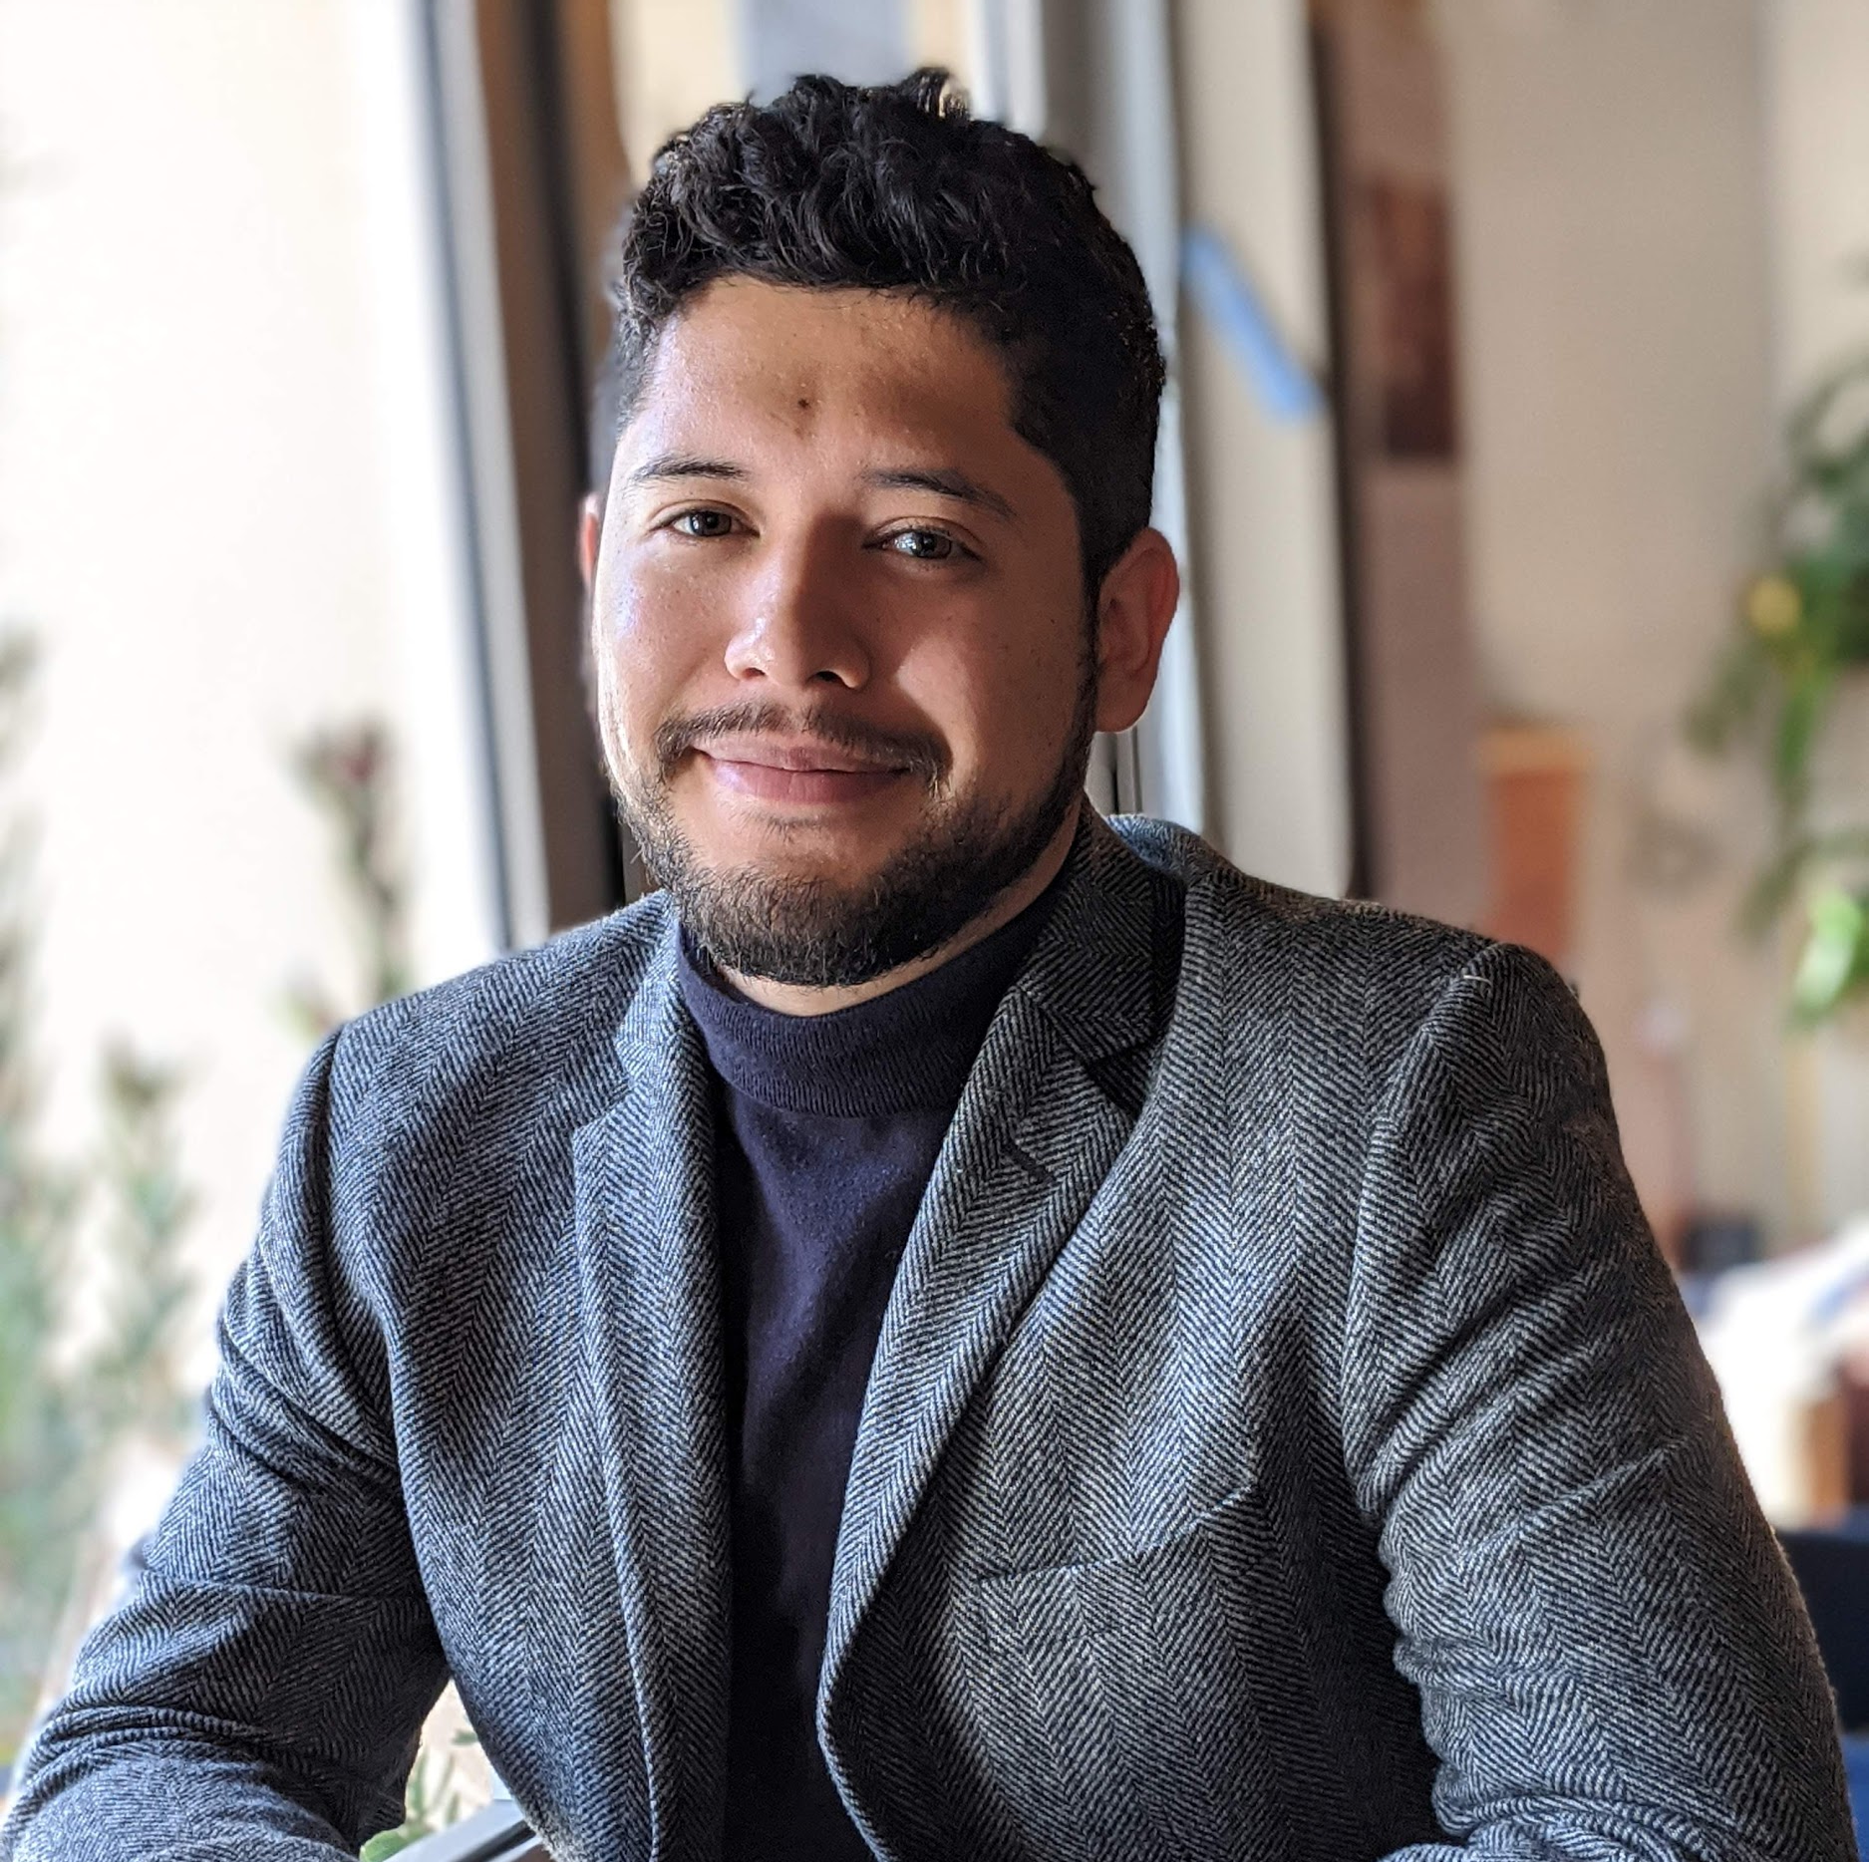
Yoon Hyung Choi
Postdoctoral Research Associate Social Media Lab, Cornell University
Daniel Vargas Campos
Education Content Specialist Common Sense Education
Notes:
Intro slide to introduce speaker etc.
This is also a great place to potentially tell a “why” story to help get the room

Slide 3
1
4
Current Trends of Social Media Use
TestDrive Implementation
2
5
History and Research Behind TestDrive
Q&A
3
Social Media TestDrive Walkthrough

Slide 4
Poll
Notes:
Do you know a tween (student ages 10-13) who has a social media account?
Yes
No
*If you do, share what platform they are using in the chat.

Slide 5
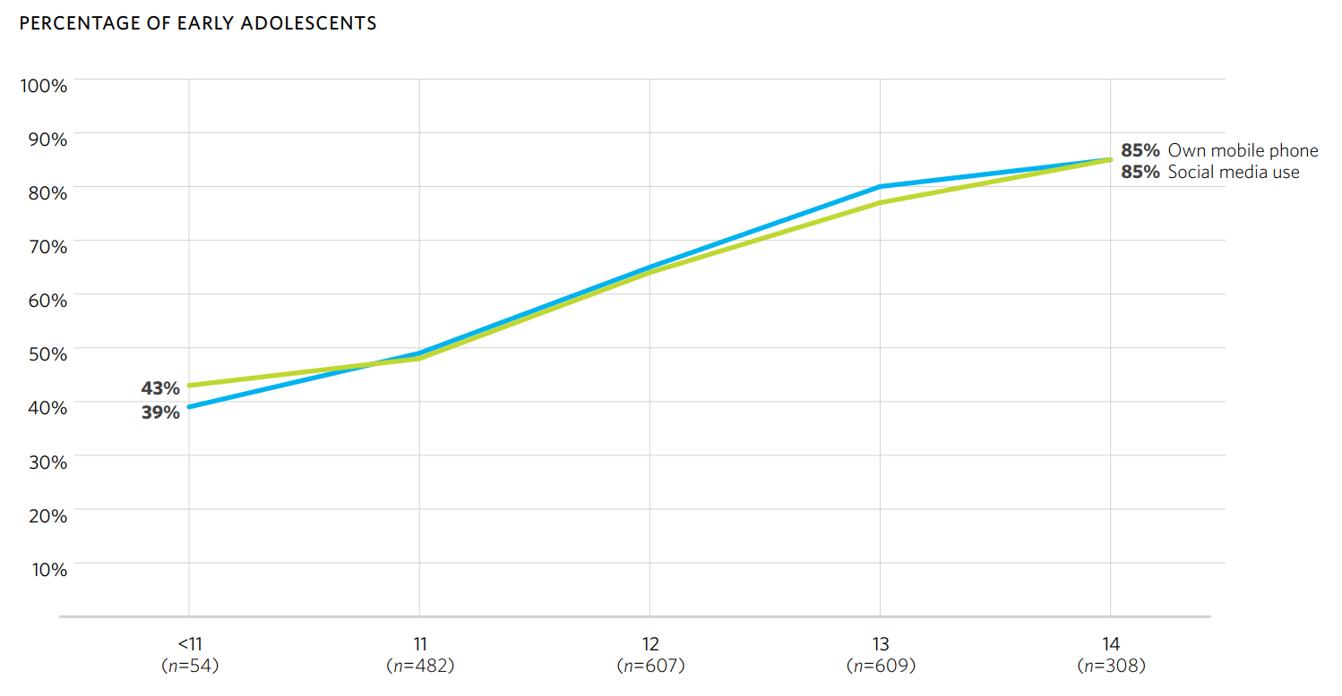
Device Access and Social Media Use
Access and quality of online experiences is not the same across groups. Low-income children are more likely to report having negative experiences on social media.
Source: Tweens, Teens, Tech, and Mental Health: Coming of Age in an Increasingly Digital, Uncertain, and Unequal World, Common Sense Media (2020)

Slide 6
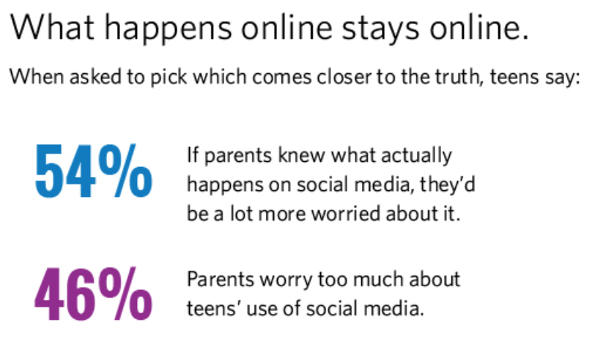
Tweens and Social Media
Source: Social Media, Social Life: Teens Reveal Their Experiences (2018)

Slide 7
Risks and Opportunities of Social Media
Source: Tweens, Teens, Tech, and Mental Health: Coming of Age in an Increasingly Digital, Uncertain, and Unequal World, Common Sense Media (2020)

Slide 8
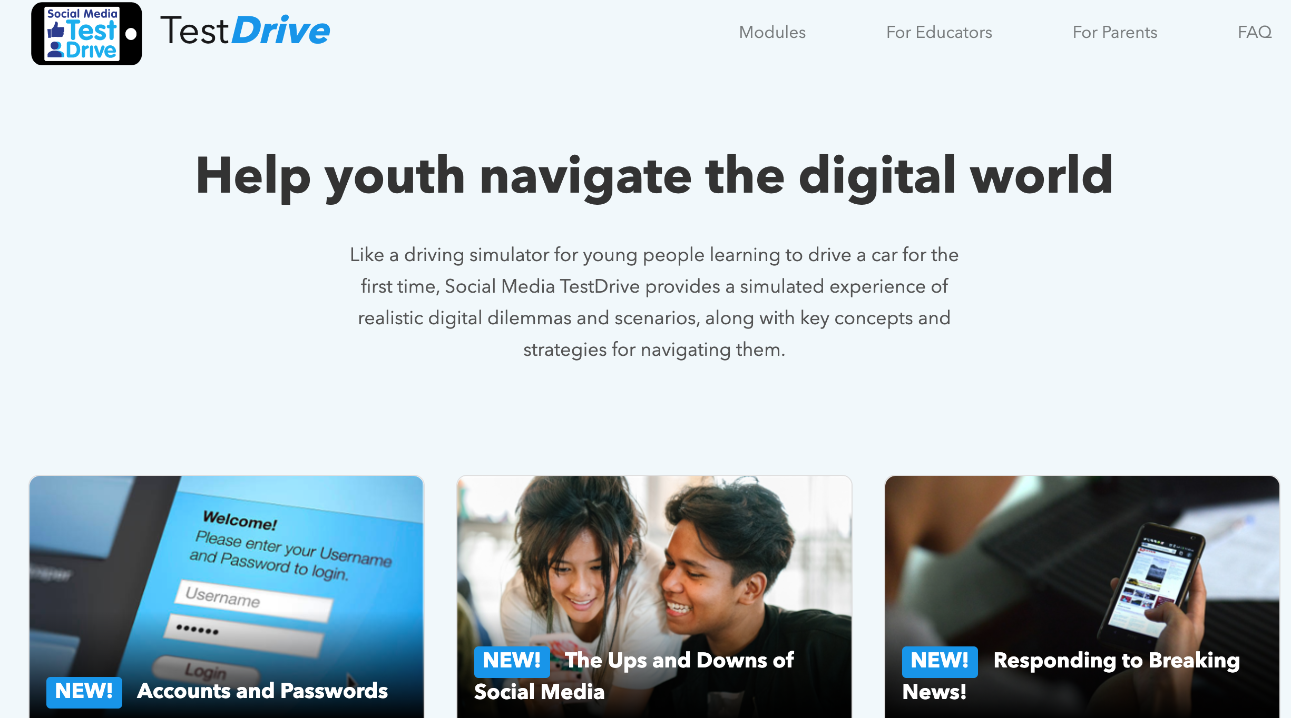
`
Social Media TestDrive
An educational tool that allows students to learn key digital citizenship topics by interacting with a social media simulation.
Notes:
Yoon starts

Slide 9
How Was TestDrive Developed?
Idea came from conversations with youth development educators
No good way for young people to practice social media skills without signing up for social media sites
Adaptation of a social media simulation research platform
Experimentation & learning in a safe, realistic environment

Slide 10
What is TestDrive?
TestDrive is a social media simulation that allows students to learn and to practice being digital citizens without having to create a real social media account!
The tool consists of 12 modules. Each module focuses on a specific digital citizenship topic and a set of related concepts.
The modules take 20 - 25 minutes to complete. Students can work on them on their own and at their own pace or as part of a synchronous class activity.

Slide 11
What Makes TestDrive Unique?
Co-developed by Common Sense Education and the Cornell Social Media Lab
Aligned to the Common Sense Digital Citizenship Curriculum and its core topics
Uses experiential learning and experimentation to foster an understanding of digital citizenship
Allows students to engage with digital dilemmas in an environment that is safe and private

Slide 12
TestDrive: Educational Goals
Solidify students’ understanding of key digital citizenship terms and concepts
Introduce students to a common social media interface and the features that will help them be safe and responsible online (e.g. privacy settings, reporting function, etc. )
Help students to develop realistic expectations of what being a digital citizen on social media looks like
Allow students to practice prosocial behaviors in an interactive setting (e.g. reporting hateful comments, identifying fake news, reflecting on their emotions, etc.)

Slide 13
Experiential Learning
“Learning from experience”
Experiences and experimentation + reflection
Concrete experience
Reflective observation
Abstract conceptualization
Active experimentation
Simulation provides a safe yet realistic social media environment for authentic experiences
Notes:
Cycle

Slide 14
TestDrive Modules at a Glance
1
Tutorial: Students are introduced to the objectives of the module as well a the relevant digital citizenship terms and definitions.
Guided Activity: Students are introduced to the TestDrive timeline. Visual aids scaffold students understanding of appropriate behaviors and actions.
2
3
Free-Play: Students practice prosocial behaviors in a setting with no aids. They are free to navigate through the timeline however they want.
Reflection: Students are asked to reflect on their engagement with the timeline in the free-play section and whether they applied the skills they learned throughout the module.
4
Notes:
Yoon final slide

Slide 15
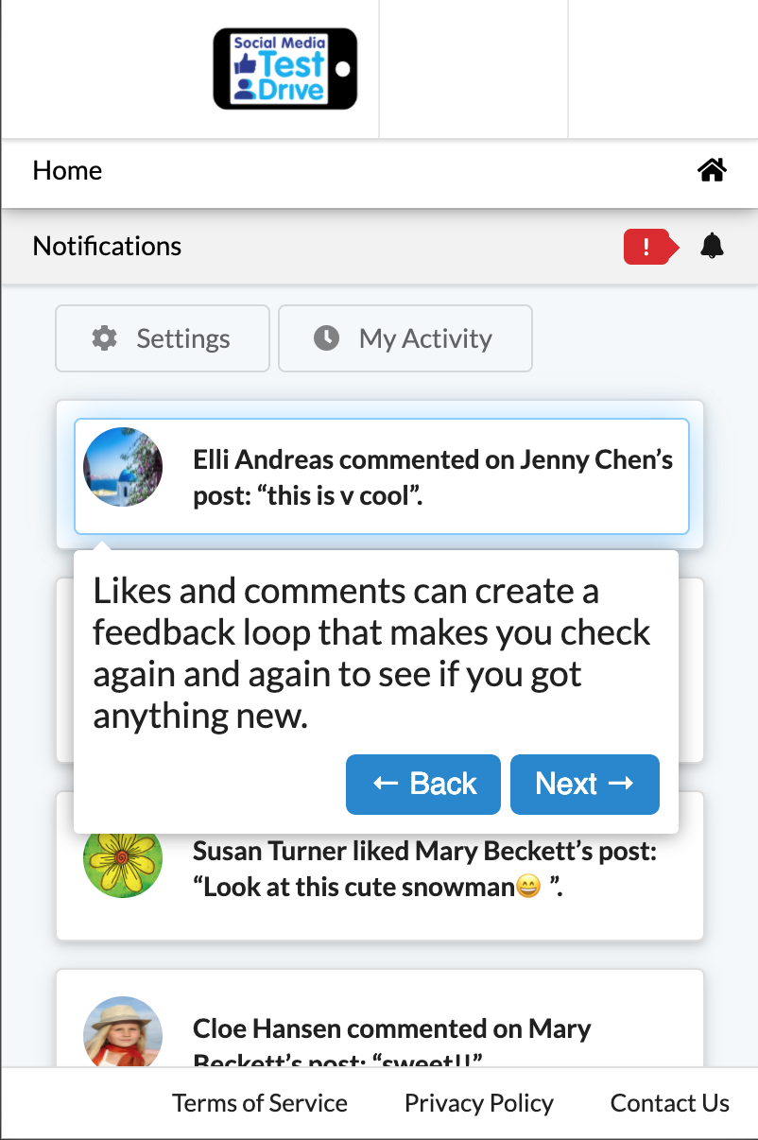
What Makes TestDrive Engaging and Safe?
Instagram-like timeline which includes:
‘Bot’ (fake) users
Scripted interactions and content
Learners can post, comment, like, etc.
Not connected to the wider internet (no information is saved)
Notes:
Daniel
Cannot talk to anyone else, cannot upload their own pictures, no information is saved

Slide 16
Poll
Notes:
Daniel
Have you ever integrated experiential learning activities in your teaching?
Share examples in the chat.

Slide 17
The Ups and Downs of Social Media
Notes:
Walkthrough - together

Slide 18
Alignment with the Digital Citizenship Curriculum
Social Media TestDrive Module | CSE Digital Citizenship Lesson | Grades | Topic
Accounts & Passwords | N/A | 5th - 6th | Privacy & Security
News in Social Media | Finding Credible News | 5th - 6th | News & Media Literacy
Is This Private Information | Chatting Safely Online | 6th - 7th | Relationships & Communication
How to Be an Upstander | Upstanders and Allies: Taking Action Against Cyberbullying | 6th - 7th | Cyberbullying, Digital Drama & Hate Speech
Shaping Your Digital Footprint | Social Media and Digital Footprints: Our Responsibilities | 6th - 7th | Digital Footprint & Identity
Online Identities | Who Are You Online? | 6th - 7th | Digital Footprint & Identity
Notes:
Daniel

Slide 19
Alignment with the Digital Citizenship Curriculum
Social Media TestDrive Module | CSE Digital Citizenship Lesson | Grades | Topic
Scams and Phishing | Don’t Feed the Phish | 6th - 7th | Privacy & Security
The Ups and Downs of Social Media | My Social Media Life | 7th - 8th | Relationships & Communication
Healthy Social Media Habits | Digital Media and Your Brain | 7th - 8th | Media Balance & Well-Being
Social Media Privacy | Being Aware of What You Share | 7th - 8th | Privacy & Security
Ads on Social Media | Big, Big Data | 7th - 8th | Privacy & Security
Responding to Breaking News | His Just In! | 7th - 8th | News Media & Literacy
Notes:
Daniel

Slide 20
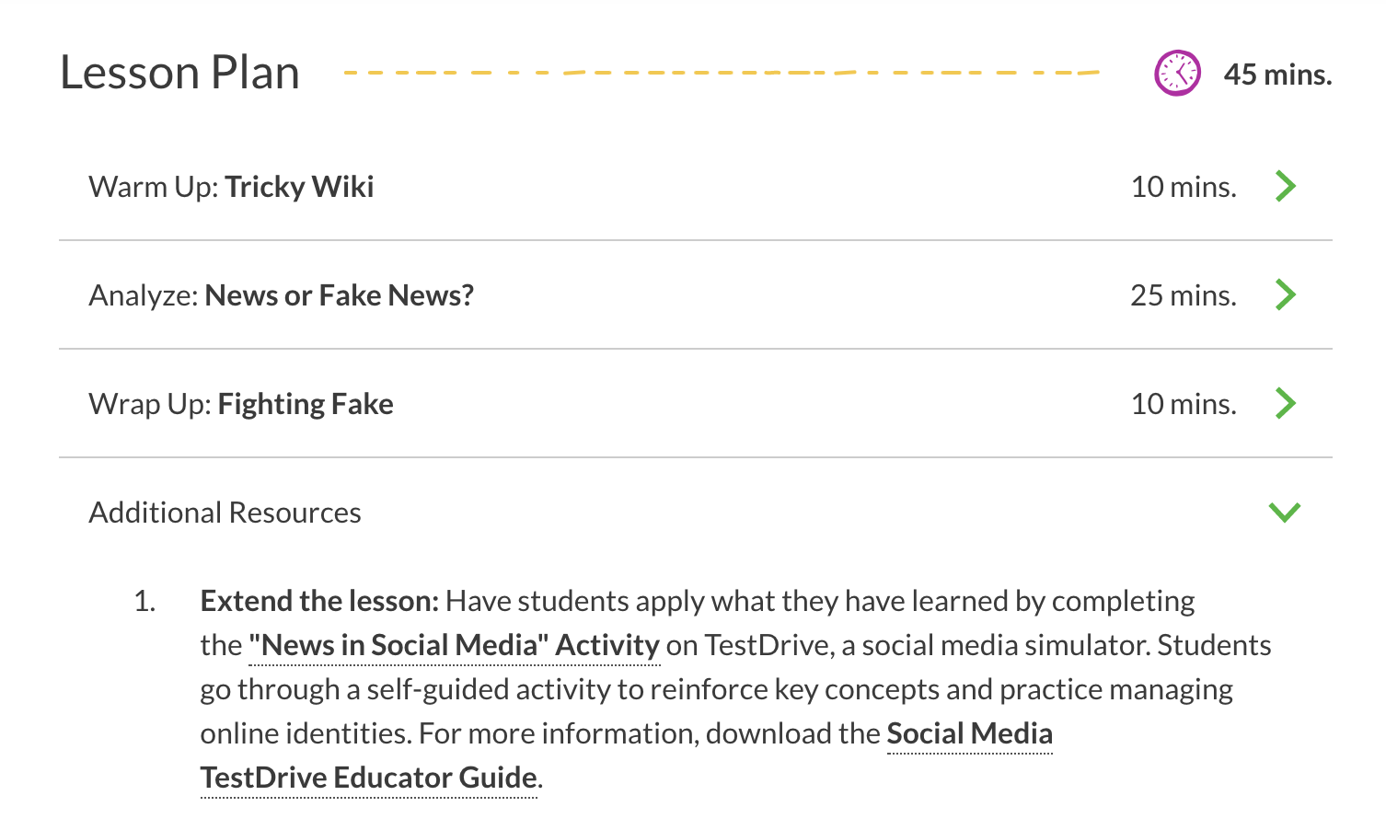
`
Suggested Aligned Activity
We suggest using TestDrive as an extension activity to one of our digital citizenship lessons.

Slide 21
Sample Activities
In-class activity led by an educator
Before module: pre-teaching of concepts (optional)
Students work through a module individually or in pairs
After module: in-class group discussion of reflection questions
Notes:
Yoon
Pilot with multiple 4-H afterschool programs in NYS

Slide 22
What our teachers and students say:
“From a teacher's perspective, they were clearly engaged and they were taking it seriously. The conversation we had afterward was rich.” - 8th grade teacher
“There was no fussing from students, they stayed connected to it. [...] The interactivity of it was engaging to them and made a difference.” - 8th grade teacher
“I really liked seeing examples and trying to respond appropriately without people commenting back to me.” - 8th grade student
Notes:
Yoon

Slide 23
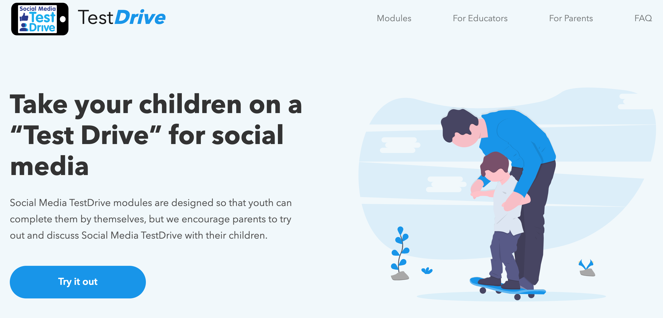
`
Family Engagement Tool
A good resource to engage parents and to encourage a whole-community implementation of Digital Citizenship.

Slide 24
Q&A

